Slide 1
THE CULTURAL REVOLUTION
BY: FATIMA VILLA

Slide 2
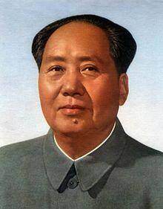
MAO
In 1966, Mao Zedong, the head of the communist party in China started The Cultural Revolution. He had lost a lot of power in the government and thought that other leaders were taking China in the
wrong direction.

Slide 3
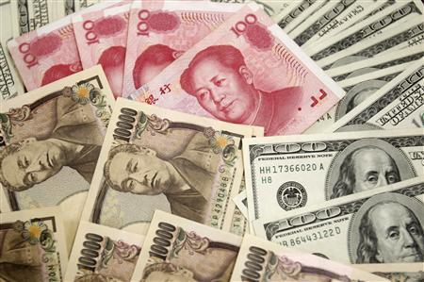
Why?
Mao felt that china was losing its ideological purity. Mao’s ,“great leap forward” was a failure and the country economy was almost ruined.

Slide 4
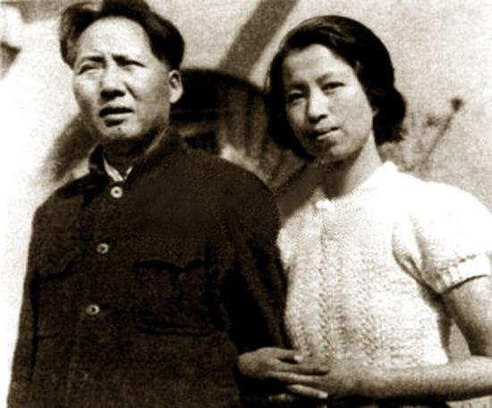
The Beginning
Mao, with a group of radicals which included his wife (Jiang Qing) attacked the current party leadership.

Slide 5
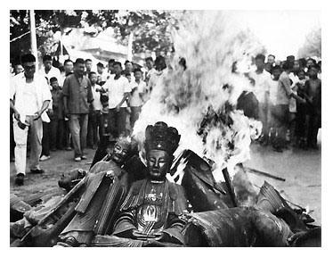
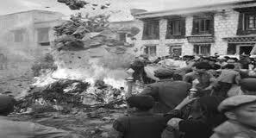
Student Led
He convinced the young people of China to rise up and purge the impure parts of chinese society and go back to the revolutionary spirit that led to victory for the communists in the Civil War twenty years before.

Slide 6
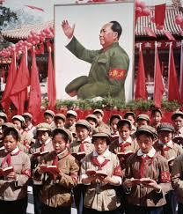
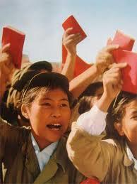
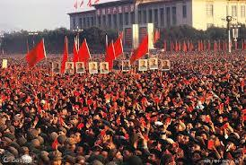
The Little Red Book
The”Little Red Book” or Mao’s quotations ,encouraged a personality cult with millions of followers.

Slide 7
Down with the old ways.
The first thing Mao did in The Cultural Revolution was to shut down the schools
He asked the students to take down the party leaders for their bourgeois values.

Slide 8
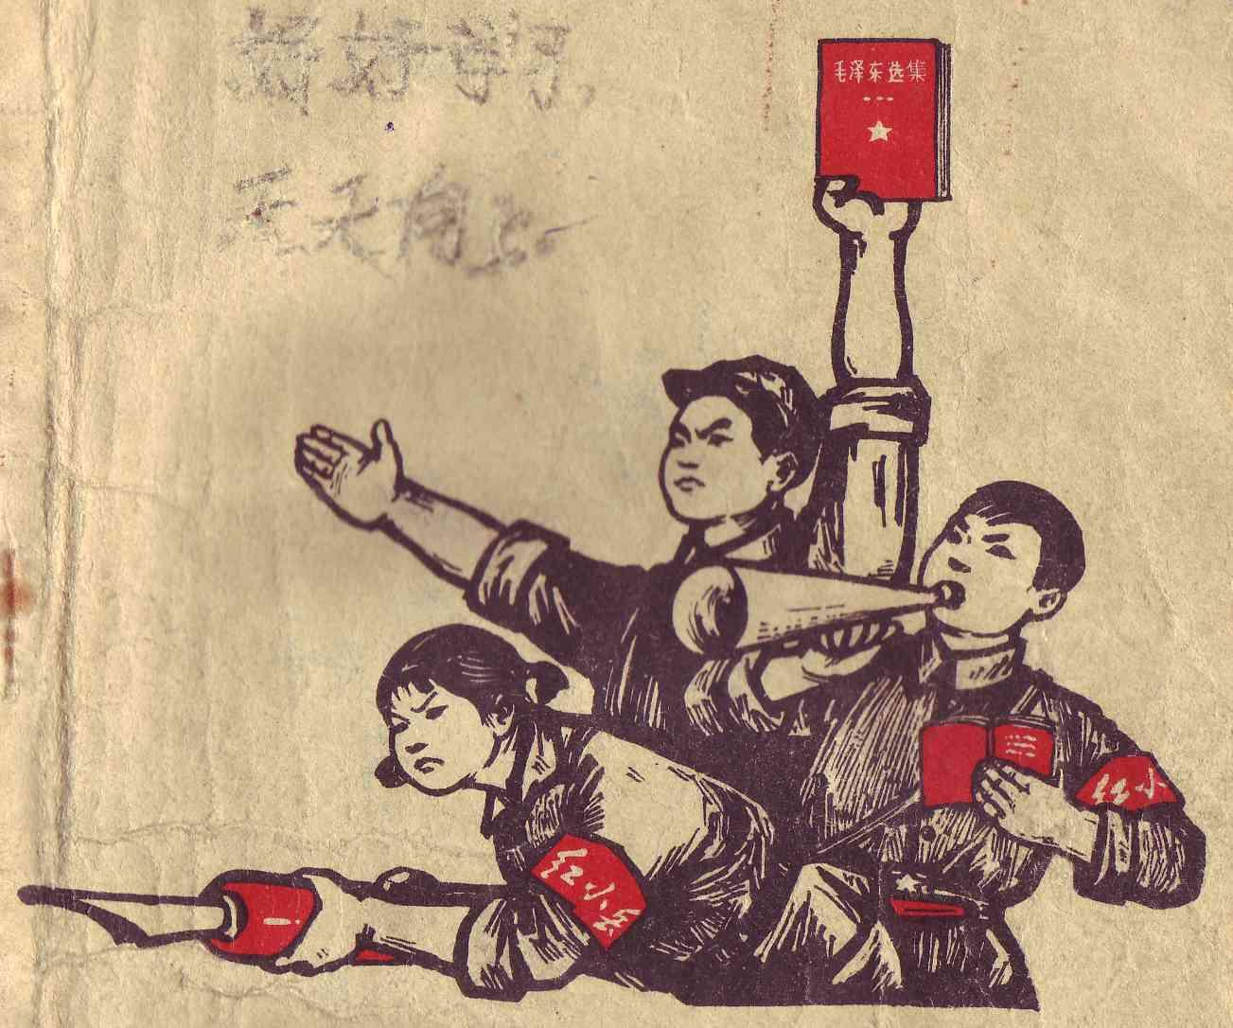
The Red Guard
The students formed paramilitary groups called the “Red Guards” and attacked China's elderly and intellectuals.
The Red Guards brought many Chinese cities to the brink of chaos.

Slide 9
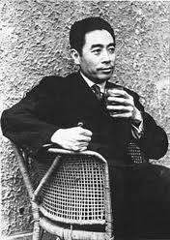
Zhou Enlai
The army forced the Red Guard into the rural areas, where they couldn't caused trouble.
Mao's revolution caused a power struggle in the chinese government.
Zhou Enlai became Mao’s partner and
chosen successor.

Slide 10
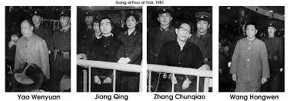
The Gang of Four
In 1972 Mao had a stroke and Zhou got cancer.
Mao’s wife Jiang and 3 other radicals became the “Gang
of Four” and took control of the government.

Slide 11
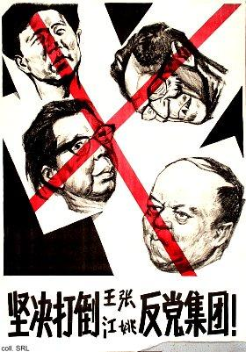
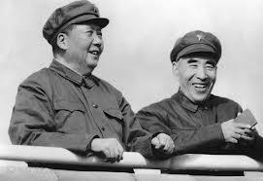
The End
In 1976 Zhou and Mao died, and the Gang Of Four were pushed out of power.
The Cultural Revolution was over.

Slide 12
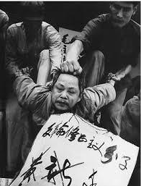
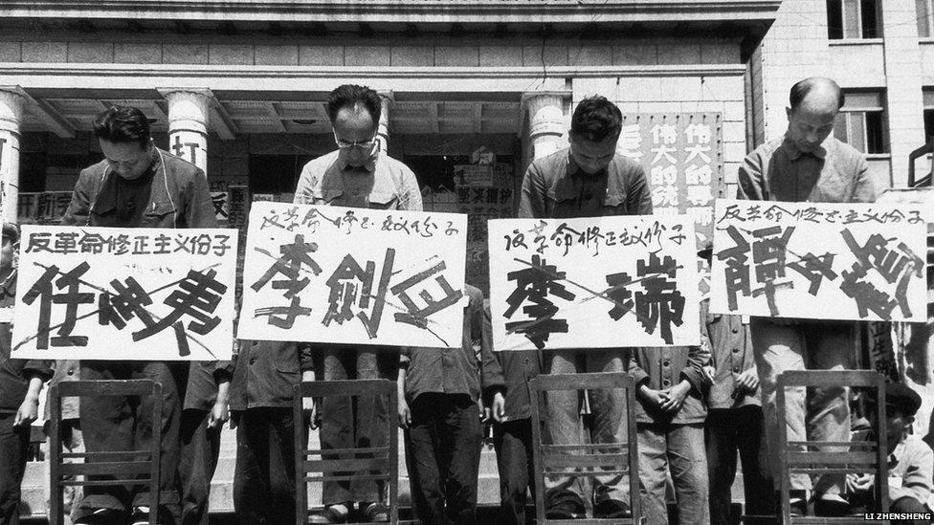
The Aftermath
1.5 million people were killed during the Cultural Revolution and million of others were put into prison, tortured, and humiliated.

Slide 13
A poem of Mao’s
The Red Army is not afraid of hardship on the march, the long march. ten thousand waters and ten thousand mountains are nothing. The five sierras meander like small waves, the summits of Wumeng pour on the plain like balls of clay. Cliffs under clouds are warm and washed below by the river. Gold, sand. Iron chains are cold, reaching over Tatu River. The fae snow of Minshan only makes us happy and when the army pushes through, we all laugh.

